Slide 1

The WealthWise Financial Platform
George Fraher, Sam Buerck, Nathan O'Brien, Michael Paulsen, Carson Vanoverbeke

Slide 2

Introduction
WealthWise Financial Advising is a digital platform designed to help individuals make informed financial decisions through:
•Personalized advisory services
•Financial management tools
•Access to financial education resources and market insights.

Slide 3
Major Problems
Inefficient Financial Management: Many individuals lack access to personalized financial tools and professional advice, leading to poor decision-making.
01
Making a comprehensive and effective means to navigate the website
02
Ensuring easy user accessibility to different resources found on the website as well as any outsourced resources
03

Slide 4
Goals
Provide
users with tailored financial advice.
Offer
tools for better financial management.
Equip
users with education and insights for informed decisions.
Ensure
data is secure at all times
Offer
a well-rounded and easy to use web app

Slide 5
Architecture Design and Design Pattern
Modular design for flexibility and scalability.
Integration of multiple systems:
- User management
- Financial tools
- Event scheduling
- Market news APIs.
- Secure backend ensuring data privacy.
Live Web Conferencing

Slide 6
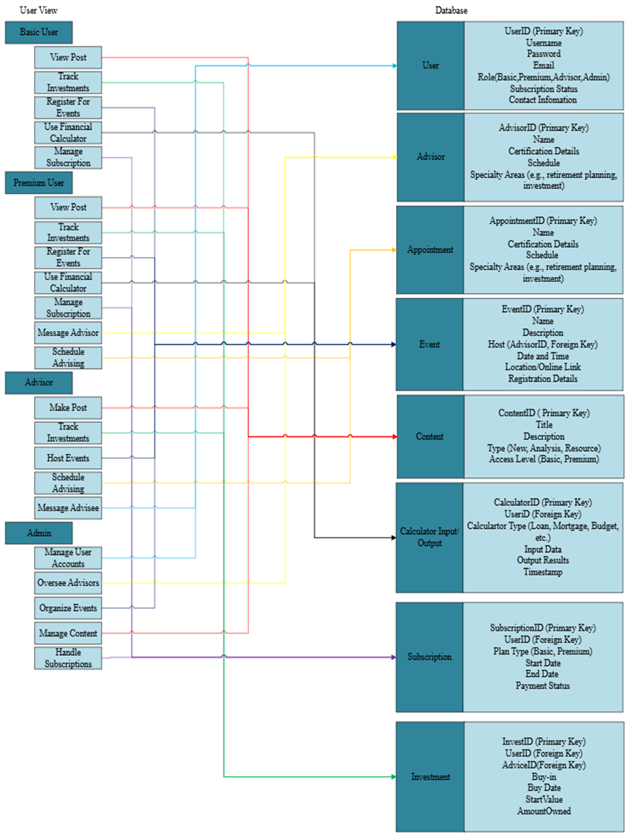
Database Diagram

Slide 7






Technologies and Tools
Git
Github
Python
SQL
VScode
Streamlit

Slide 8

Challenges and Solutions
Challenges Related to the Project
Knowing what direction to take the platform (UI, Backend planning etc.)
Ensuring Security and Usability for users.
Knowing what tools to make this project tangible.
Our Challenges
Conflicting Schedules
Procrastination
Set Deadlines

Slide 9
Conclusion
Making WealthWise Financial Advising be a user friendly place that is easy to navagate

